Slide 1
SQL Data Types

Slide 2
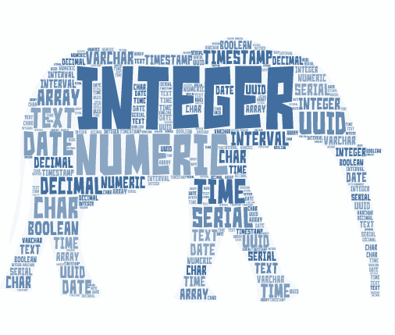
SQL Numerical Data Types
Numerical Data types are numbers stored in database columns.
Exact Numerical
Approximate Numerical

Slide 3
Types of Numerical Data Types
Exact Numerical types have their precision and scale preserved.
example : All INTEGER types , DECIMAL
Approximate Numerical types have their precision preserved but with a floating scale.
example : FLOAT , DOUBLE
Minimum and Maximum values of Exact numerical can be estimated but it cannot be estimated for Approximate numericals.

Slide 4
Exact Numerical: Integer
Type | Storage (Bytes) | Minimum Value Signed | Maximum Value Signed
TINYINT | 1 | -128 | 127
SMALLINT | 2 | -32768 | 32767
MEDIUMINT | 3 | -8388608 | 8388607
INT | 4 | -2147483648 | 2147483647
BIGINT | 8 | -2⁶³ | 2⁶³-1

Slide 5
Exact Numerical: Integer-Unsigned
Type | Storage (Bytes) | Minimum Value Unsigned | Maximum Value Unsigned
TINYINT | 1 | 0 | 255
SMALLINT | 2 | 0 | 65535
MEDIUMINT | 3 | 0 | 16777215
INT | 4 | 0 | 4294967295
BIGINT | 8 | 0 | 2⁶⁴-1

Slide 6
Why Unsigned?
Age cannot be negative
Age cannot be more than 255
Prevent negative values being inserted
Customer Age
38
41
19
27
98

Slide 7
Exact Numerical: Decimal
Syntax: DECIMAL (p,s) - Fixed Length Floating type
Where P is Precision and S is Scale
For Example: decimal (4,2)
ex - 29.21 , 30.10 etc..

Slide 8
Exact Numerical: Decimal
Default Min Max
P - 18 1 65
S - 0 0 30
NOTE : parameter S (Scale) can only be specified if P (Precision) is specified and scale must always be less than or equal to the precision.
“DEC” , “NUMERIC” , “FIXED” Data Types are similar to DECIMAL.

Slide 9
Approximate Numerical: Float
FLOAT and "DOUBLE" are used to store the floating point numbers
FLOAT consumes 4 bytes with maximum 7 digits after the decimal
DOUBLE consumes 8 bytes with maximum 15 digits after the decimal .
FLOAT/DOUBLE in SQL are used to store very large or very small values.
Store Approximate value not the Exact value.

Slide 10
Approximate Numerical: Float Example
87000000000000 → 8.7e13 → 8.7*10¹³ → 87000000000000
87000000000001 → 8.7000000000001e13 → 8.7000000e13 → 87000000000000

